Slide 1


Online ADMM:
Based ELM vs SVM
Classification
Group 15:
Sarvesh Ram Kumar – CB.SC.U4AIE24048
Adwaidh– CB.SC.U4AIE24003
Nikhileshwara Reddy– CB.SC.U4AIE24063

Slide 2
Introduction :
Problem Context
In many domains (e.g., materials science, real estate, finance), large datasets are generated. Learning models must be fast, accurate, and scalable to handle these datasets. Traditional models like SVM are powerful but computationally heavy with very large data.
The project focuses on predicting concrete compressive strength using machine learning. We apply Extreme Learning Machine (ELM) and Support Vector Machine (SVM) for classification. Online Learning, where each data group is trained on by the models separately will be done as comparison.
Supervised Learning :
Here, we used 3 datasets to test ELM vs SVM and compare the results.
First Dataset : Here, we frame concrete compressive strength prediction as a classification task:
  1. Low strength (< 20) 2. Medium strength (20–40) 3. High strength (> 40)
Second Dataset : IRIS Dataset : Iris Setosa(0), Iris Versicolour(1), or Iris Virginica(2)
Third Dataset : Rice Classification : Jasmine(1) and Gonen(0)
To improve efficiency and reduce computation time, we also use ADMM to explore feature selection.
Finally, we compare the performance of ELM vs SVM in terms of accuracy and computation.

Slide 3
ELM and SVM:
Extreme Learning Machine (ELM):
A single hidden layer feed forward neural network. Hidden layer weights are randomly assigned and not tuned.
Output weights are learned using least squares solution. Provides fast training and good generalization.
Support Vector Machine (SVM)
A supervised learning model for classification and regression. Finds an optimal hyperplane that separates data into classes. Known for high accuracy and strong theoretical foundation.
Comparison That are Done :
ELM vs ELM with ADMM Feature Selection (Offline)
ELM with ADMM Feature Selection (Offline) vs ELM with ADMM Feature Selection (Online)
ELM Comparison with regards to SVM (Offline and Online)

Slide 4
Datasets & Overall Flow of Project :
First Dataset:
Source : UCI Machine Learning Repository :
Concrete Compressive Strength Dataset
Size : 1,030 samples, 9 attributes
Features : Cement, Blast Furnace Slag, Fly Ash, Water,
Superplasticizer, Coarse Aggregate, Fine Aggregate,
Age (days)
Target : Concrete compressive strength(Low/ Medium/ High)
Second Dataset:
Source : UCI Machine Learning Repository :
Iris Flower Dataset
Size : 150 samples, 5 attributes
Features : Sepal length (cm), Sepal width (cm), Petal length (cm),
Petal width (cm)
Target : Iris species (classes: Setosa / Versicolor / Virginica)
Third Dataset :
Source : Kaggle , Size : 18135 samples
Features : 10 , Target : Jasmine or Gonen
Overall Flow of the Project:
Dataset Preprocessing
Read the Dataset. Classify the data if necessary
ADMM & Splitting
Feature Selection (according to data) & Split into train, test
Training Models
Extreme Learning Machine(ELM) & SVM
Without ADMM
With ADMM
ELM vs SVM
Online Learning
Analysis of Results

Slide 5
Proposed Methodology / Design :
Steps followed for the classification in ELM and SVM:
Importing the Necessary Libraries : Pandas, Numpy and Sklearn
Importing Dataset and Preprocessing : Concrete Compressive Strength, where preprocessing will be done to create 3 total classes which are Low/Med/High.
Feature Scaling and Splitting of Dataset : Feature Scaling the values like normalization and splitting into train, test data groups to train on the models separately
ADMM for Feature Selection : Alternating Direction Method of Multipliers (ADMM) is an optimization algorithm. Applied here to shrink less important feature weights to zero. This way, ADMM helps us select only the most relevant features while ignoring redundant ones. Reduces model complexity & improves efficiency, especially for large datasets.
Train the respective models : Train on the Designed ELM Model and SVM Model
Analysis of the Results :
ELM vs SVM( With & Without Feature Selection)
ELM Online Training Results

Slide 6
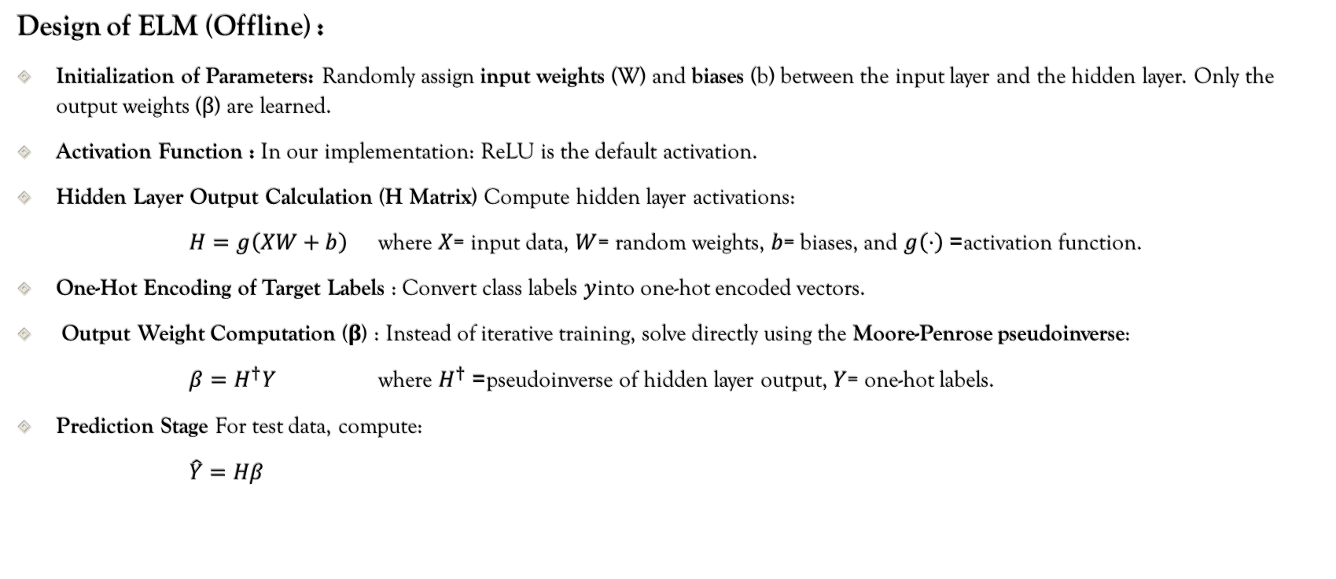
ELM Offline vs Online Design :
Design of ELM (Offline) :
Initialization of Parameters: Randomly assign input weights (W) and biases (b) between the input layer and the hidden layer. Only the output weights (β) are learned.
Activation Function : In our implementation: ReLU is the default activation.
Hidden Layer Output Calculation (H Matrix) Compute hidden layer activations:
$H=g\left(XW+b\right)$where $X$= input data, $W$= random weights, $b$= biases, and $g\left(⋅\right)$= activation function.
One-Hot Encoding of Target Labels : Convert class labels $y$into one-hot encoded vectors.
Output Weight Computation (β) : Instead of iterative training, solve directly using the Moore-Penrose pseudoinverse:
$β=H^{†}Y$where $H^{†}$= pseudoinverse of hidden layer output, $Y$= one-hot labels.
Prediction Stage For test data, compute:
$\hat{Y}=Hβ$

Slide 7
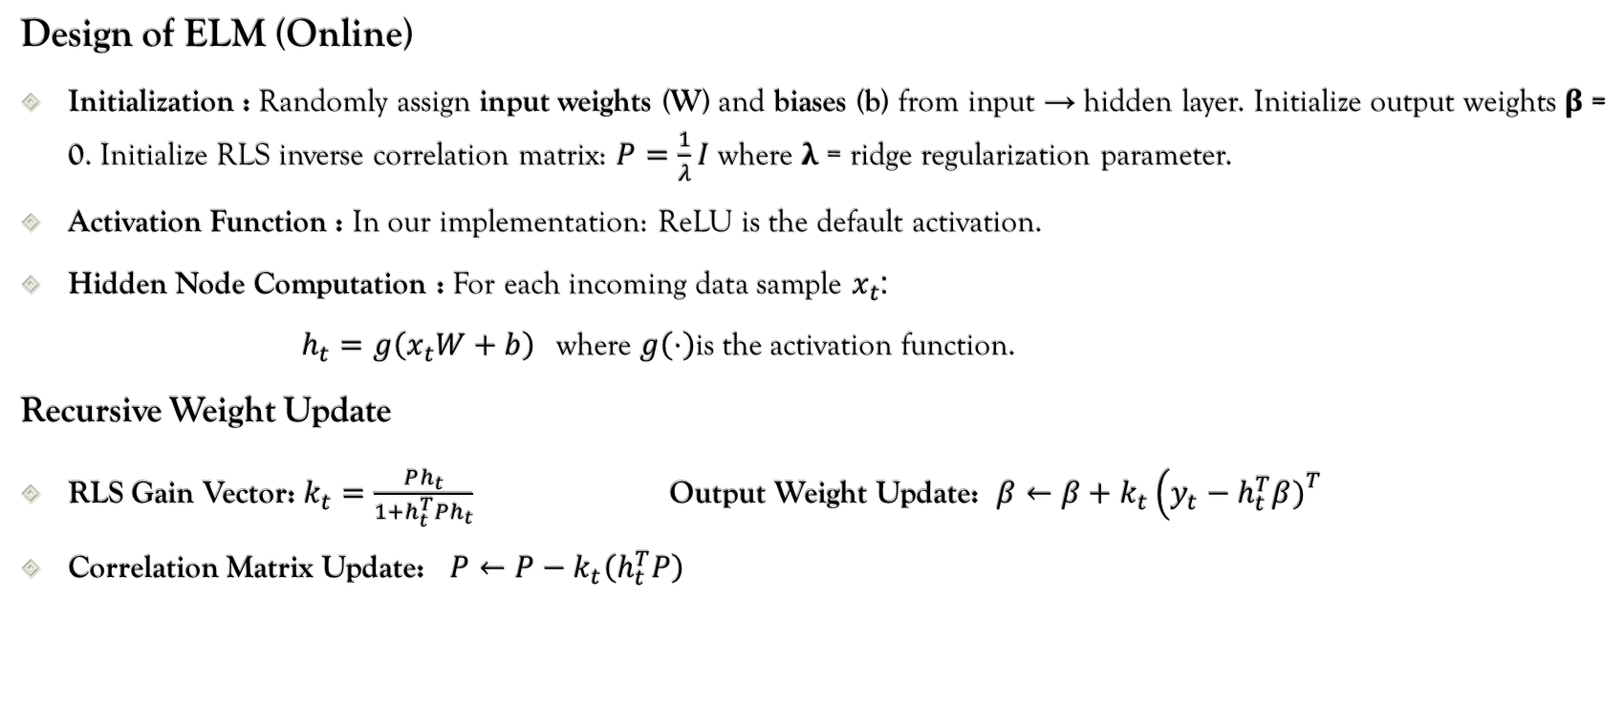
ELM Offline vs Online Design :
Design of ELM (Online)
Initialization : Randomly assign input weights (W) and biases (b) from input → hidden layer. Initialize output weights β = 0. Initialize RLS inverse correlation matrix: $P=\frac{1}{λ}I$ where λ = ridge regularization parameter.
Activation Function : In our implementation: ReLU is the default activation.
Hidden Node Computation : For each incoming data sample $x_{t}$:
$h_{t}=g\left(x_{t}W+b\right)$where $g\left(⋅\right)$is the activation function.
Recursive Weight Update
RLS Gain Vector: $k_{t}=\frac{Ph_{t}}{1+h_{t}^{T}Ph_{t}}$Output Weight Update: $β←β+k_{t}\left(y_{t}−h_{t}^{T}β{\left.)\right.}^{T}\right.$
Correlation Matrix Update: $P←P−k_{t}\left(h_{t}^{T}P\right)$

Slide 8
Ridge, Correlation Matrix & RLS Gain :
Ridge:
The ridge parameter is a regularization constant (λ in ridge regression).
It prevents overfitting and numerical instability when computing the recursive update of β.
Correlation Matrix(P):
Keeps track of the inverse correlation of hidden activations.
Used to compute the RLS gain vector k, which tells us how much to adjust β for each new sample.
RLS Gain Vector:
k = gain vector, size (hidden dim, 1)
Determines how much β should change based on the error for this sample.
k​ = how much to adjust weights in the direction of h
Ensures fast convergence and avoids recalculating matrix inverses

Slide 9
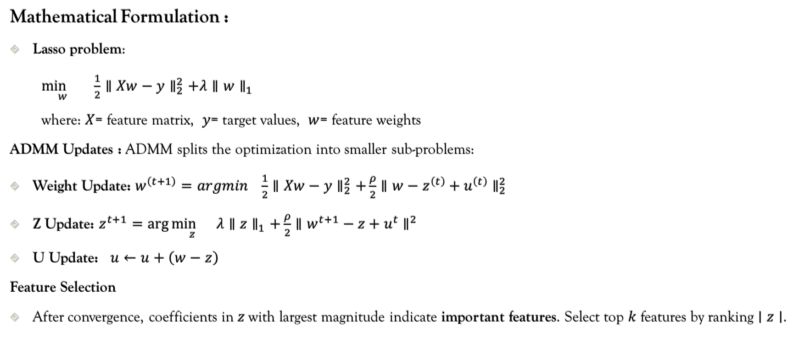
ADMM Feature Selection Design:
Mathematical Formulation :
Lasso problem:
$\underset{w}{\min{}} \frac{1}{2}∥Xw−y∥_{2}^{2}+λ∥w∥_{1}$
where: $X$= feature matrix, $y$= target values, $w$= feature weights
ADMM Updates : ADMM splits the optimization into smaller sub-problems:
Weight Update: $w^{\left(t+1\right)}=argmin \frac{1}{2}∥Xw−y∥_{2}^{2}+\frac{ρ}{2}∥w−z^{\left(t\right)}+u^{\left(t\right)}∥_{2}^{2}$
Z Update: $z^{t+1}=\arg{\underset{z}{\min{}}}λ∥z∥_{1}+\frac{ρ}{2}∥w^{t+1}−z+u^{t}∥^{2}$
U Update: $u←u+\left(w−z\right)$
Feature Selection
After convergence, coefficients in $z$with largest magnitude indicate important features. Select top $k$features by ranking $∣z∣$.

Slide 10
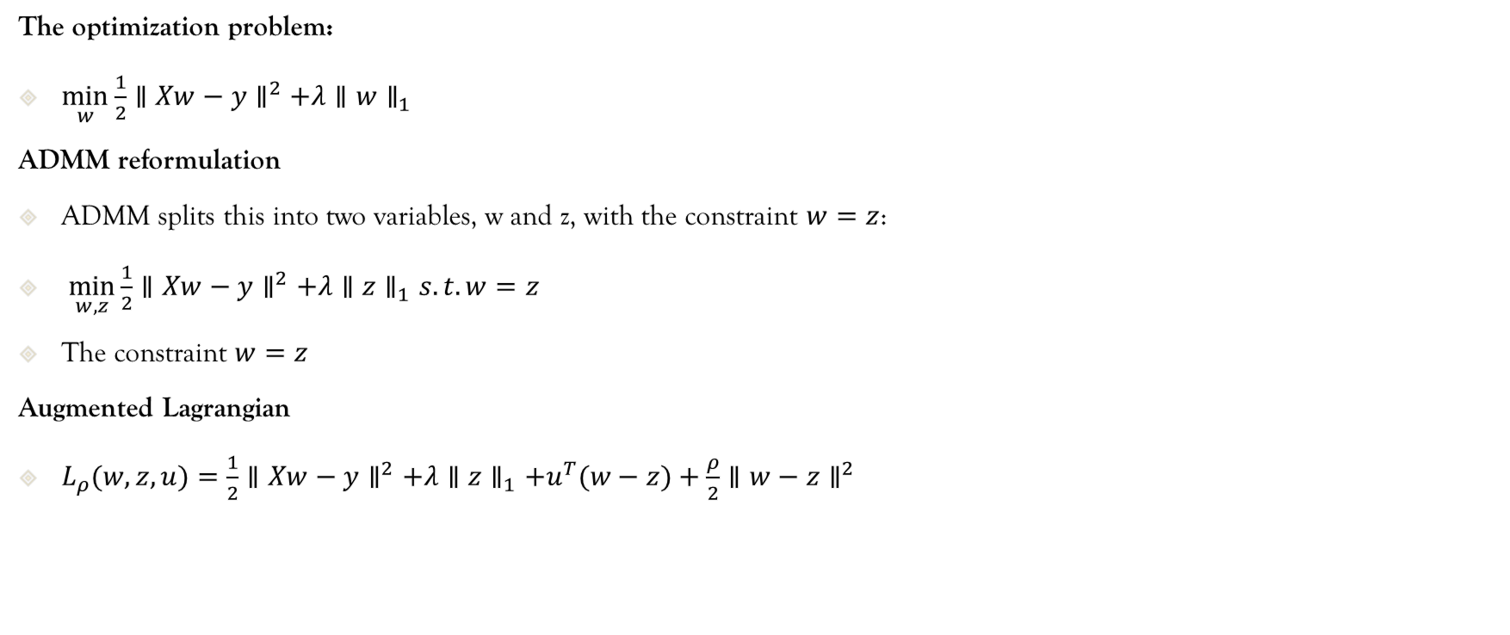
ADMM Feature Selection Design:
The optimization problem:
$\underset{w}{min⁡}\frac{1}{2}∥Xw−y∥^{2}+λ∥w∥_{1}$
ADMM reformulation
ADMM splits this into two variables, w and z, with the constraint $w=z$:
$\underset{w,z}{min⁡}\frac{1}{2}∥Xw−y∥^{2}+λ∥z∥_{1}s.t. w=z$
The constraint $w=z$
Augmented Lagrangian
$L_{ρ}(w,z,u)=\frac{1}{2}∥Xw−y∥^{2}+λ∥z∥_{1}+u^{T}(w−z)+\frac{ρ}{2}∥w−z∥^{2}$

Slide 11
Results: All Accuracy Comparisons with/without Feature Selection:
Dataset One: Compressive Strength Prediction :
S.no | Without Feature Selection(1) | With Feature Selection(2) | Online Training(3)
ELM | 79.61% | 72.33% | 75.33%
SVM | 86.41% | 84.95% | --
Confusion Matrices:
ELM(1):
ELM(2):
ELM(3):
SVM(1):
SVM(2):
Low
Med
High
34 | 4 | 1
7 | 66 | 18
7 | 20 | 49
33 | 6 | 0
8 | 74 | 9
1 | 26 | 49
32 | 7 | 0
8 | 74 | 9
4 | 14 | 58
36 | 3 | 0
3 | 84 | 4
1 | 17 | 58
36 | 3 | 0
4 | 85 | 2
0 | 22 | 54
Low Med High
Low Med High
Low Med High
Low Med High
Low Med High

Slide 12
Results: All Accuracy Comparisons with/without Feature Selection:
Dataset Two: IRIS Dataset:
S.no | Without Feature Selection(1) | With Feature Selection(2) | Online Training(3)
ELM | 96.67% | 93.33% | 83.44%
SVM | 96.67% | 96.67% | --
Confusion Matrices:
ELM(1):
ELM(2):
ELM(3):
SVM(1):
SVM(2):
0
1
2
10 | 0 | 0
0 | 9 | 1
0 | 1 | 9
10 | 0 | 0
0 | 6 | 4
0 | 1 | 9
10 | 0 | 0
0 | 10 | 0
0 | 1 | 9
10 | 0 | 0
0 | 9 | 1
0 | 0 | 10
10 | 0 | 0
0 | 9 | 1
0 | 0 | 10
0 1 2
0 1 2
0 1 2
0 1 2
0 1 2

Slide 13
Results: All Accuracy Comparisons with/without Feature Selection:
Dataset Three: Rice Classification Dataset:
S.no | Without Feature Selection(1) | With Feature Selection(2) | Online Training(3)
ELM | 99.29% | 99.12% | 99.20%
SVM | 99.23% | 99.10% | --
Confusion Matrices:
ELM(1):
ELM(2):
ELM(3):
SVM(1):
SVM(2):
0
1
1623 | 17
9 | 1988
1623 | 17
15 | 1982
1621 | 19
10 | 1987
1620 | 20
8 | 1989
1619 | 21
11 | 1986
0 1
0 1
0 1
0 1
0 1

Slide 14
Analysis of the Results:
Accuracy Analysis
ELM
  Without feature selection: 79.61% With top-5 ADMM feature selection: 72.33%
  Online training: 75.33%
  Slight decrease in accuracy due to loss of information from discarded features.
  Online learning achieves intermediate accuracy while enabling incremental learning.
SVM
  Without feature selection: 86.41% With top-5 ADMM feature selection: 84.95%
  Only minor accuracy drop, showing SVM handles feature reduction better for this dataset.
Observation:
SVM consistently outperforms ELM in offline batch learning for this dataset. Feature selection reduces computational complexity and may slightly impact accuracy, but helps generalization.
Online ELM provides a good trade-off between accuracy and incremental learning capability.

Slide 15
Thank You

